Slide 1
This Ain’t Your Grandpa’s Alzheimer’s: Issues Specific to Younger-Onset Dementias
Presented by:
Alzheimer’s Association - Houston & Southeast Texas Chapter

Slide 2
Objectives
Recognize types of dementia
Identify the emotional and physical impact of younger-onset dementia
Explore ethical implications of issues specific to younger-onset dementia
Discuss how a diagnosis influences family dynamics
Identify strategies to overcome these challenges

Slide 3
Dementia
Dementia is a general term for loss of memory and other mental abilities severe enough to interfere with daily life. It is caused by physical changes in the brain.
Set of symptoms describing loss of mental functions
Thinking
Reasoning
Remembering
Judgment

Slide 4
Dementia
Frontotemporal Lobe Dementias
Vascular Dementia
Reversible Dementias
Lewy Body Dementia
Alzheimer’s Disease

Slide 5
Younger-Onset Dementia
Symptoms of dementia first appear ≤ 65 years of age
Higher prevalence of rarer dementias
Often presents and progresses differently than dementia in older age

Slide 6
Prevalence of Younger-Onset Dementia
An estimated 220,000- 640,000 Americans are living with younger-onset dementia.
The individuals living with younger-onset dementia in the U.S. could fill the stands of Minute Maid Park well over 5 times!

Slide 7
Common Forms of Younger-Onset Dementias
Frontotemporal lobar degeneration (FTLD)
Primary Progressive Aphasia (PPA)
Behavioral Variant Frontotemporal degeneration (bvFTD)
Progressive Suprancuclear Palsy (PSP)
Corticobasal Degeneration (CBD)
FTD- Motor Neuron Disease (MND)
Alzheimer’s Disease (AD)
Posterior Cortical Atrophy (PCA)
Primary Progressive Aphasia (PPA)

Slide 8
HIV and the Brain

Slide 9
HIV and the Brain
Persons with HIV can experience neurological complications, including dementia.
HIV can cross the blood-brain barrier and come in contact with the brain & spinal cord.

Slide 10
HIV and the Brain
Different levels of HIV-related dementia:
Minor Cognitive Motor Disorder (MCMD)
Very subtle symptoms (at least two of the following)
Impaired attention and concentration
Mental slowing
Impaired memory
Changes in personality

Slide 11
HIV and the Brain
AIDS Dementia Complex (ADC)
Often happens when the CD4+ (helper white blood cells) count falls below 200 cells/microliter
ADC is considered an “AIDS-defining condition”
Symptoms can include:
Poor concentration
Mental slowness
Difficulty learning new things
Changes in behavior
Forgetfulness/Memory loss
Confusion
Difficulty finding words
Withdrawal from hobbies or social activities
Depression

Slide 12
HIV and the Brain
How is ADC diagnosed?
Neuroimaging
Analyzing the CSF (cerebrospinal fluid)
Neuropsychological testing

Slide 13
HIV and the Brain
Good news
In the early days, 40-60% of people living with AIDS experienced ADC.
Aggressive antiretroviral therapy has significantly lowered the rates of ADC and can improve mental function if you do have ADC.

Slide 14
Issues Surrounding Younger – Onset Dementias

Slide 15
Diagnostic Issues
Diagnostic issues reported by 71% of care partners
An average of 3.4 years before diagnosis
Misdiagnosis common
Creates frustration and grief for family members

Slide 17
Workplace & Financial Issues
Cognitive changes more apparent in workplace
Many leave job or are fired well before diagnosis
Loss of benefits
Financial problems
Loss of purpose

Slide 18
Family Dynamics

Slide 19
Self
Enormous need to maintain a sense of self and purpose
Difficulty in shift of roles and responsibilities
Risk of social isolation

Slide 20
Care Partner
Feelings of losing a partner
Feelings of “being robbed of the future”
Must manage role changes

Slide 21
Kids and Teens
May feel obligated to stay at home, hold off on plans for school or a move
May be concerned about genetics and their risk of developing the disease in the future
May have trouble understanding or accepting the disease of the parent
Spend more time away from home
Stop inviting friends over
Argue more
Have problems at school
Express physical pain like a headache or stomachache

Slide 22
Lack of Services
There is a lack of adequate, age-related services for individuals with younger-onset and their families, especially home-based and community services
Placement to a facility can often prove difficult for families, and younger-onset individuals tend to remain at home many years after the diagnosis is established
Lack of resources can lead to higher caregiver burden

Slide 23
Recommendations

Slide 24
Work Place Issues
Must recognize that work is extremely important to us, providing a tremendous amount of self-worth
Must take safety into account when deciding whether to continue working
It is strongly recommended that individual receives diagnosis, understands benefits before revealing diagnosis in the workplace

Slide 26
Work Place Accommodation
The Americans with Disabilities Act- provides limited protection to people with dementia in the workplace. Companies with at least 15 or more employees are to make “reasonable” accommodations for employees with physical or mental disabilities
Employers can:
Match tasks with remaining ability
Use employee’s over-learned and over-remembered skills
Limit distractions
Help plan and organize daily activities (daily written schedule/check list)
Maintain a structured routine during the work day

Slide 27
Transitioning into Retirement
Finding new opportunities for meaningful activity and social engagement is critical
If the spouse is still working, the person with dementia should be in an environment during the day which is stimulating and works with their strengths

Slide 28
Social Security Disability Insurance
Eligibility
An employee with younger-onset dementia will be considered if they cannot perform at the same working capacity as they did before their illness.
Social Security decides that the employee cannot adjust to other work because of their condition
The disability must also be expected to last for at least one year or to result in death
Compassionate Allowance
Younger-onset dementia listed as a condition for compassionate allowance in February 2010
Significantly speeds up the SSDI process so individuals can receive benefits as soon as possible
Conditions that quality include: Early-Onset Alzheimer’s Disease, Mixed Dementia, Primary Progressive Aphasia (PPA), Frontotemporal Dementia (FTD), Pick’s Disease-Type A, Creutzfeldt-Jakob Disease (CJD)

Slide 29
Legal & Financial
Durable power of attorney for financial matters
Medical power of attorney & HIPAA waiver
Prepare a living will (medical directive) for the individual
Obtain guardianship for young children
Consider public benefit programs such as Medicaid and VA
Long-term care insurance

Slide 30
Supportive Resources/Programming
Similar to what is recommended for older adults with dementia:
Adult Day Centers
In-Home Respite
Creative Art Therapy
Counseling (individual/family)
Support Groups
Seek out age-specific resources when available
Younger-Onset Care Partner Support Group
Contact Teri Miller: 800.272.3900

Slide 31
Support for Children
Be honest and upfront about the disease and what to expect
Let them know that the emotions they are feeling are normal
Create opportunities for expression of feelings
Emphasize it is not their fault & they cannot catch the disease
Inform teachers & school counselors

Slide 32
Community Resources
Notes:
Introduce yourself and provide your own reason for volunteering/presenting
- share your experience, personal comment, or story to establish rapport

Slide 33
Information and Resources
Website
www.alz.org/texas
33

Slide 34
Online Caregiving Center
ALZConnected: message boards
Alzheimer’s Navigator: helps caregivers make care-related decisions
Community Resource Finder: a database of local programs and services
CareTeam Calendar: helps organize family and friends who want to help in caregiving activities

Slide 35
Early Stage Programming
Learning Together
Discovering Connections
Community Arts Program for Persons with Early Stage Dementia
35
Notes:
Misperception of what early stage really is. Early stage individuals have capabilities and are still extremely functional.
We didn’t think we needed to connect until mid stage…now we have progressed to identifying it earlier and therefore we begin the connections sooner.

Slide 36
Care Consultation
Licensed staff are available to help with the difficult decisions and uncertainties associated with Alzheimer’s
Assessment of needs
Assistance with planning and problem solving
Supportive listening
Available by telephone, e-mail or in person
36
Notes:
Read through slide. A fee is associated with Care Consultations – although no one will be turned away due to finances.

Slide 37
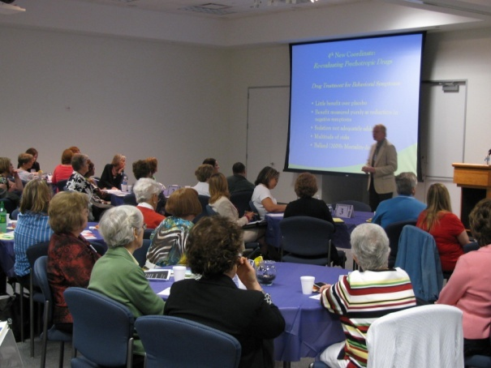
Special Events
Professional Conferences
Caregiver Conferences
Research Updates
37
Notes:
The Alzheimer’s Association also hosts special events each year. In the Spring, we offer a Professional Conference and in the Fall, a Caregiver Conference. We also provide a Research Symposium and Update which is open to both the public and professionals in the research arena. Also in the Fall is a research update featuring a local researchers from Baylor College of Medicine. September 21st is World Alzheimer’s Day which also provides an opportunity for you to participate in a special event.

Slide 38
Support Groups
Over 50 support groups in 37 counties
38
Notes:
Support Groups are offered for both the caregiver and PWD.
Read through slide.

Slide 39
Global Leader in Alzheimer’s Research
Currently funding over $80 million of more than 350 active projects in 21 countries

Slide 40
TrialMatch
“The E-Harmony of Clinical Trials”

Slide 41
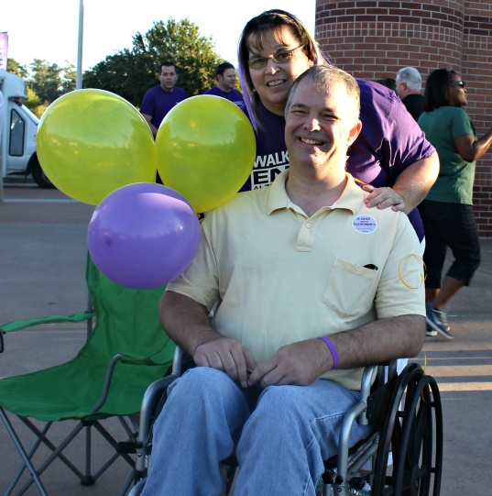
Walk to End Alzheimer’s
HOUSTON
Walk to End Alzheimer’s 2016
Saturday, November 5th
41
Notes:
A great way to become involved is through the Walk to End Alzheimer’s. Create a team today!

Slide 42
Volunteer Opportunities
Health Fairs
Speakers Bureau
Support Group Leaders
Walk to End Alzheimer’s
Advocacy
42
Notes:
Read volunteer opportunities.

Slide 43
Advocacy
Advocates call for advancements in research and enhanced care and support at the federal, state and local levels.
43
Notes:
Each year, a group from our local chapter goes to Washington D.C. for the public policy forum. Featured on this slide is our Early Stage manager with Roger, who has been diagnosed with Early-Stage Alzheimer’s disease.

Slide 44
Alzheimer’s Association
HELP Line: 800.272.3900
www.alz.org/texas
44

